Slide 1


Introduction to
Robotic Process Automation
Customer Feedback Analysis
220701227
RITHVIK M
DURAI MURUGAN N
COMPUTER SCIENCE AND ENGINEERING

Slide 2
Abstract
The Customer Feedback Analysis Bot is an advanced Robotic Process Automation (RPA) solution developed using UiPath Studio, designed to streamline sentiment analysis of customer reviews. Leveraging the AI Center's ML capabilities and trained on the IMDb dataset, the bot automates the process of analyzing customer feedback to classify sentiments as "very positive“ ,"positive“ ,"neutral “, "negative" or "very negative" providing precise accuracy metrics. The workflow involves reading input data from an Excel sheet, processing it through a machine learning model, and generating detailed sentiment analysis reports stored in an Excel file. Additionally, the bot sends the results via email, ensuring efficient and accurate communication of insights. This automation reduces manual effort, enhances data processing speed, and empowers businesses with actionable insights to improve customer satisfaction.

Slide 3
Need for the Proposed System
Eliminates Manual Effort: Automates the sentiment analysis process, reducing dependency on human intervention.
Improved Accuracy: Ensures consistent and error-free sentiment classification using ML models.
Timely Results: Speeds up the analysis process, enabling quick decision-making.
Enhanced Insights: Provides granular sentiment categorization with accuracy metrics to help identify trends in customer feedback.

Slide 4
Advantages of the Proposed System
Time Efficiency: Automates repetitive feedback analysis, allowing stakeholders to focus on strategic tasks.
Accuracy and Consistency: Leverages AI-driven models to eliminate human error in sentiment evaluation.
Cost Savings: Reduces operational costs by minimizing manual effort.
Improved Decision-Making: Delivers actionable insights promptly for business improvements.
Scalability: Can handle increasing volumes of feedback without compromising performance.

Slide 5
Literature Survey
AI Models for Sentiment Analysis: Pre-trained models like IMDb enable accurate sentiment classification, detecting nuanced customer sentiments.
RPA in Data Automation: Tools like UiPath streamline repetitive tasks such as data collection, analysis, and reporting, ensuring consistency and accuracy.
Challenges in Feedback Processing: Issues like incomplete data and large volumes are addressed by integrating ML models with RPA for efficient analysis.
Case Studies: Successful RPA implementations have reduced processing times and enhanced decision-making across industries like e-commerce and banking.

Slide 6
Main Objective
To automate the end-to-end process of customer feedback analysis, enabling real-time sentiment categorization, trend prediction, and actionable insights for better decision-making and customer relationship management.

Slide 7
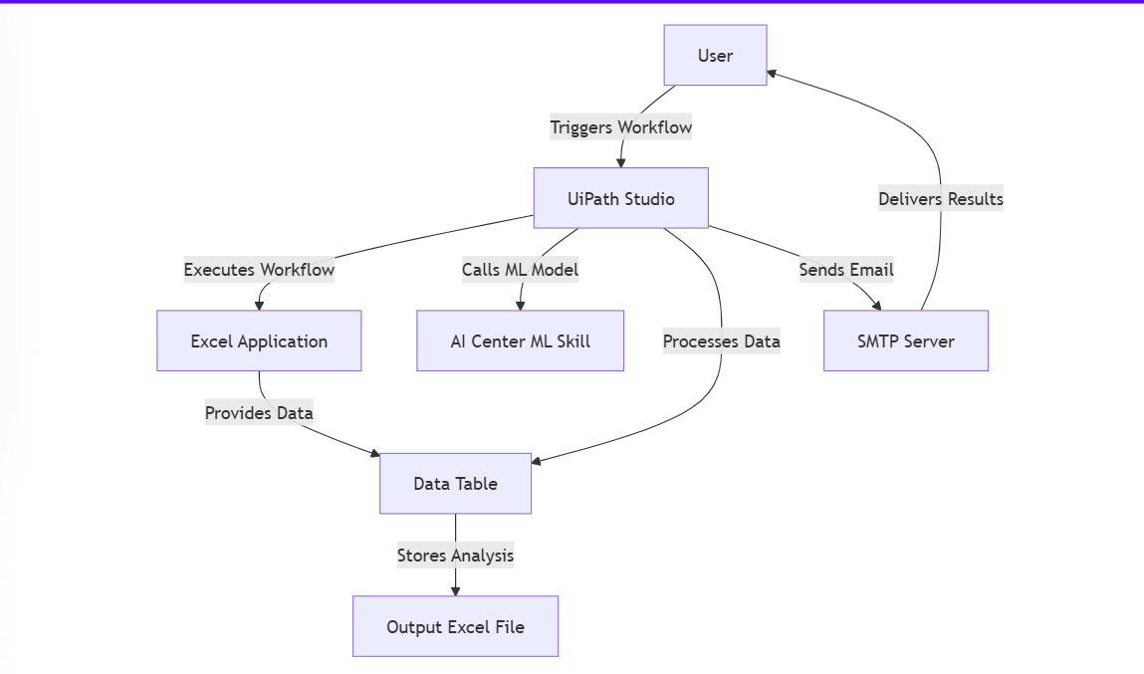
Architecture

Slide 8
System Requirements
Hardware
Software
Processor: Dual-core (2.0 GHz or higher)
RAM: Minimum 4 GB
Storage: 50 GB free disk space
Network: Stable internet connection (10 Mbps or higher)
Operating System: Windows 10 or higher (64-bit)
RPA Tool: UiPath Studio
AI Center: For deploying ML models
Data Processing: Excel/CSV support
Email Client: Microsoft Outlook or Gmail

Slide 9
Functional Description
Module 1: Feedback Collection
Extract data from emails, surveys, and social media using RPA.
Store structured data in Excel for analysis.
Module 2: Sentiment Analysis
AI categorizes feedback into sentiments: Very Positive, Positive, Neutral, Negative, Very Negative.
Module 3: Trend Prediction
Time-series analysis predicts customer satisfaction trends.
Module 4: Reporting
Generate Excel-based reports with visual graphs and share via email.

Slide 10
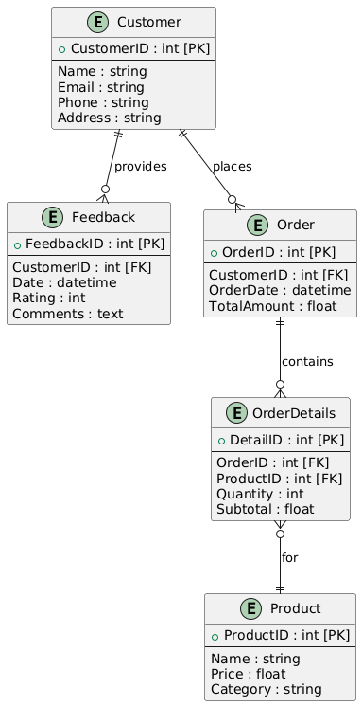
Table Design

Slide 11
Process Design
Process Design for Customer Feedback Analysis Bot
Read Input: Fetch feedback data from an Excel file.
Preprocess Data: Clean and structure the data.
Analyze Sentiments: Use the ML model to classify sentiments with accuracy scores.
Store Results: Save analyzed data into a new Excel file.
Generate Report: Compile a detailed sentiment report.
Send Email: Automatically email the report to stakeholders.

Slide 12
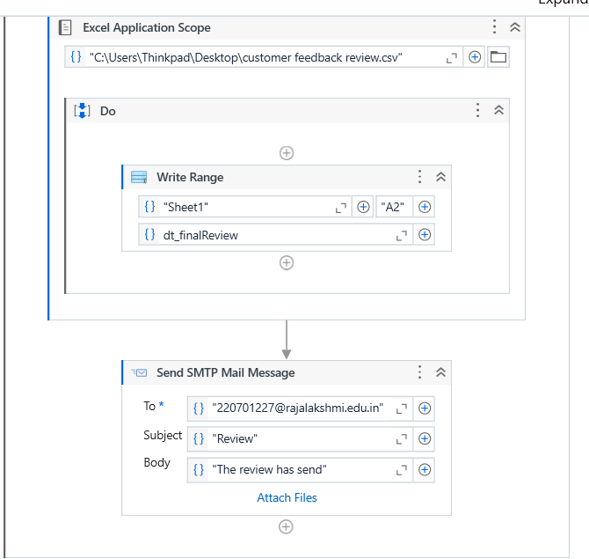
Implementation
The generated review has send through g-mail

Slide 13
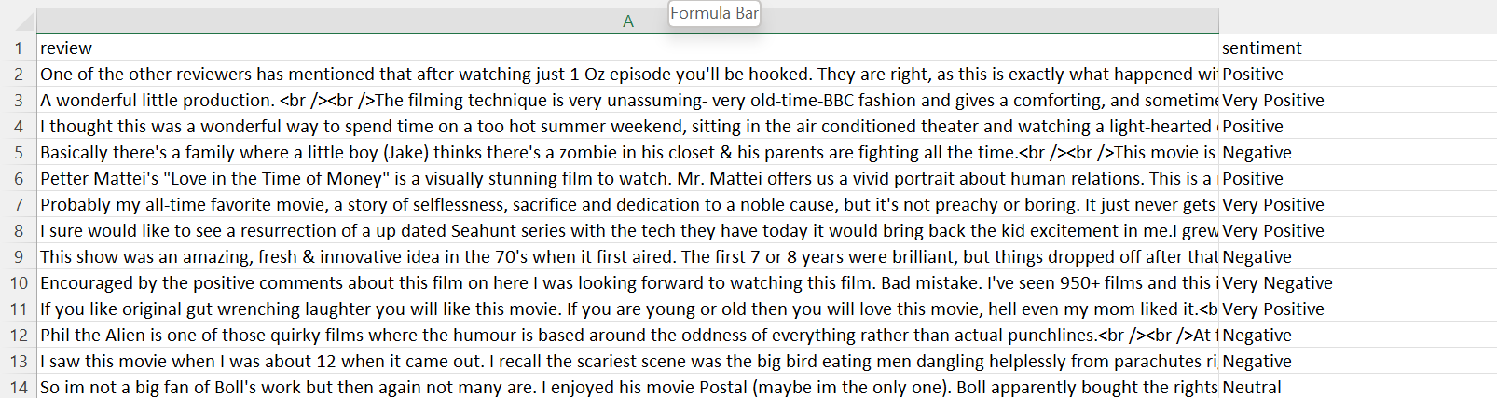
Testing

Slide 14
Conclusions
The Customer Feedback Analysis Bot revolutionizes feedback processing by automating sentiment analysis and report generation. It reduces manual effort, improves accuracy, and ensures consistent, timely insights, empowering businesses to address customer concerns proactively. The scalable and efficient solution supports data-driven decision-making, enabling improved customer satisfaction.

Slide 15
Future Enhancement
Advanced Insights:
  Incorporate AI to identify recurring feedback patterns and suggest business improvements.
Integration with Cloud:
  Store reports in cloud platforms like Google Drive or OneDrive for easy access and collaboration.
Real-Time Analysis:
  Extend capabilities to process live feedback streams for instant sentiment insights.

Slide 16
References
Liu, B. (2015). Sentiment Analysis and Opinion Mining.
Mehta, A., & Patel, K. (2023). AI-Powered Feedback Analysis.
Zhang, Y., & Wang, L. (2021). Machine Learning in Customer Sentiment.

Slide 17
Thank You

